Slide 1
Create Test Plan

Slide 2
Step 1) Analyze the product
Who will use the website?
Admin
Manager
HR team
Some specific employees
*
Software Testing
‹#›

Slide 3
Step 1) Analyze the product
What is it used for?
People management: HR Administration, Employee Management
Compensation: Payroll, Leave Management, Time tracking
Recruitment: Recruitment (ATS), Onboarding
Culture: Training, Performance Management
*
Software Testing
‹#›

Slide 4
Step 1) Analyze the product
How will it work?
Mobile: Android (Google Play), iOS (App Store)
Website: Starter version
*
Software Testing
‹#›

Slide 5
Step 1) Analyze the product
What are software/ hardware the product uses?
  User manual: https://www.orangehrm.com/assets/Files/OHRM-User-Guide.pdf
  Documents:
    Support: https://help.orangehrm.com/hc/en-us
    Github: https://github.com/orangehrm/orangehrm
*
Software Testing
‹#›

Slide 6
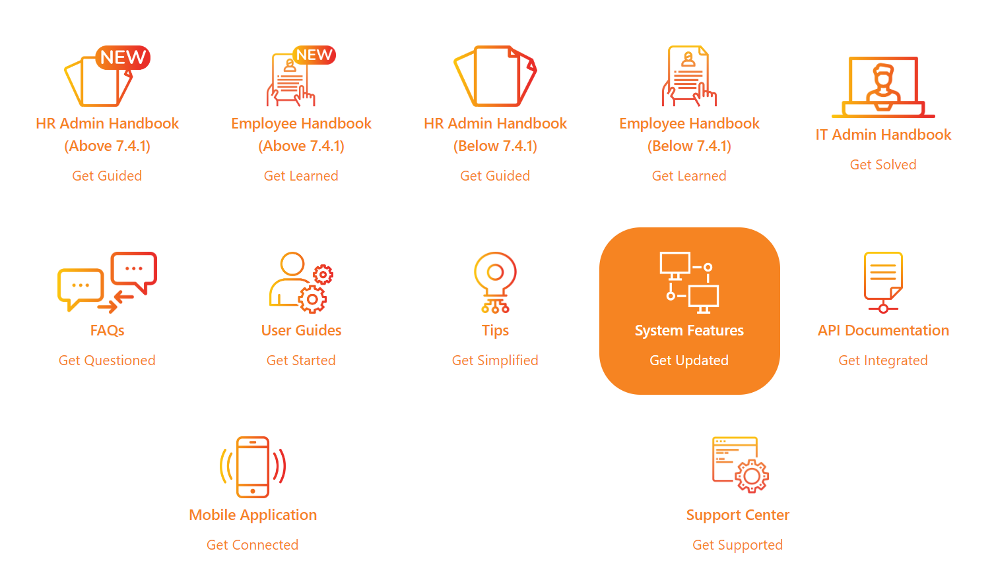
Step 1) Analyze the product
What are software/ hardware the product uses?
*
Software Testing
‹#›

Slide 7
Step 2) Develop Test Strategy
Step 2.1) Define Scope of Testing
HR administration platform
  Custom User Roles
  Audit Trail
  Notifications
Employee information
  Dashboard
  Employee Database & Profiles
  Organization Chart
  Document Templates
In-scope items: Manual based testing, Record and Replay, Model based testing, Comparison test, Blur test
Out of scopes items: Logical database, Hardware and API testing
*
Software Testing
‹#›

Slide 8
Step 2) Develop Test Strategy
Step 2.2) Identify Testing Type
Domain testing
GUI
Automation
Performance
*
Software Testing
‹#›

Slide 9
Step 2) Develop Test Strategy
Step 2.3) Document Risk & Issues
Human risks:
Lack of skills of GUI testing, UX testing, don’t know how to use testing tool
Wrong time estimate for testing project
Team leader has poor management skills
A lack of cooperation of team members.
Team members don’t understand how to use the website
Technical risks:
The testing env may not be setup properly like real business environment
Design wrong test cases
*
Software Testing
‹#›

Slide 10
Step 2) Develop Test Strategy
Step 2.4) Create Test Logistics
Who will test? All members of team H
When will the test occur?
When we have test specs and requirement document, test environment is set up.
*
Software Testing
‹#›

Slide 11
Step 3) Define Test Objective
Core HR Administration:
  Control access to employee’s personal information
  Track development in workflow
  Keep employees updated
  Manage all assets of workplace systematically
Performance Management:
  Managers can create custom goals and assigning to employees
  Managers can build custom review questions
  Deliver automated prompts to manager and employee for signing
*
Software Testing
‹#›

Slide 12
Step 3) Define Test Objective
Leave Management:
  Employees request and approve leaves.
  Assign work to another employee.
  Access insights about staffing and set up rules.
Time and Attendance Management:
  Clock in and clock out using the mobile app.
  Clarify pay policies and daily or weekly time tracking.
  Access pay hours reports about high-performing employees.
*
Software Testing
‹#›

Slide 13
Step 3) Define Test Objective
Check if the interface of the application has any errors or not
Check if the user experience has been optimized
Check the domain name as well as the links for errors
*
Software Testing
‹#›

Slide 14
Step 4) Define Test Criteria
Suspension Criteria
  Suspension rate: 40%
  Criteria for suspension:
    Critical path deadline is missed so that the client will not accept the delivery even if all testings are completed
    Unavailability of external dependent systems during execution
    When a defect is introduced that may not allow further testing process
    If server crashes
    If application crashes
  Criterias for resumption: When all suspension issues are resolved and suspension rate is not over 40%
*
Software Testing
‹#›

Slide 15
Step 4) Define Test Criteria
Exit Criteria
100% test cases executed
90% test cases passed
Desired and sufficient coverage of the requirements and functionalities under the test.
All the identified defects are corrected and closed.
*
Software Testing
‹#›

Slide 16
Step 5) Resource Planning
Human Resources
Test Manager: manage and define directions, strategies, plan…
Tester: execute test and reports bug findings,
Includes Automation Tester and Manual Tester
Test designer: create test specification
*
Software Testing
‹#›

Slide 17
Step 5) Resource Planning
System Resources
Server includes web, database and application servers.
Test tool: simulate user operation, generate test results.
Network: Wifi, 4G
Computer: how the user access the web
*
Software Testing
‹#›

Slide 18
Step 6) Plan Test Environment
Pre-requisites softwares:
  Apache HTTP Server 1.3 or later
  MySQL 5.1.6 or later
  PHP 5.3.0 or later
  Windows 10 or above
  Firefox, Chrome, Edge,…
*
Software Testing
‹#›

Slide 19
Step 6) Plan Test Environment
Minimum hardware requirements
  Processor - Intel x86-64 Architecture 1.8GHz processor or equivalent
  RAM - 8GB or more
  Hard disk - 40GB or more
  Network - network with speed at least 5MB/s
How to setup:
  https://www.orangehrm.com/assets/Files/OHRM-User-Guide.pdf
*
Software Testing
‹#›

Slide 20
Step 7) Schedule & Estimation
Task estimation
Task | Members | Estimate Effort
Create test specification | Test manager | 16 man-hour
Design test case | Test designer, Tester | 48 man-hour
Set up test environment | Test manager, tester | 16 man-hour
Perform test execution | Tester | 40 man-hour
Test report | Test manager, Tester | 10 man-hour
Test delivery | Test manager | 14 man-hour
Total |  | 144 man-hour
*
Software Testing
‹#›

Slide 21
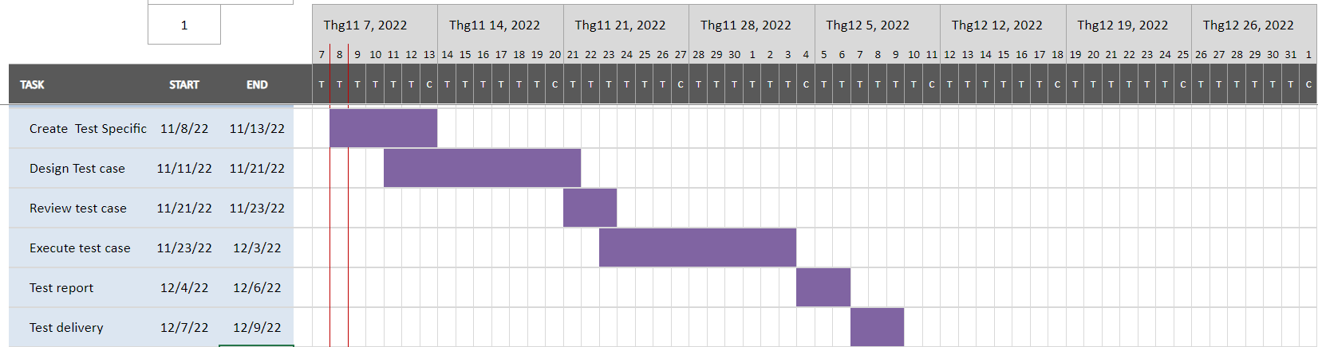
Step 7) Schedule & Estimation
Schedule
*
Software Testing
‹#›

Slide 22
Step 8) Test Deliverables
Test deliverables are provided before testing phase.
  Test plans document.
  Test cases documents
  Test Design specifications.
Test deliverables are provided during the testing
  Test Scripts
  Simulators.
  Test Data
  Test Traceability Matrix
  Error logs and execution logs.
Test deliverables are provided after the testing cycles is over.
  Test Results/reports
  Defect Report
  Installation/ Test procedures guidelines
  Release notes
*
Software Testing
‹#›

